Slide 1

Collaborating on code Version control systems with git and github
Dr. Jason B. Shepherd

Slide 2
Our Timeline for “Collaborating on Code”
Read up through Section 2.4 “Undoing Things” before the third day of class.
I will “lift” up some core ideas from the reading.
You should familiarize yourself with the mechanics (e.g., “How do I add changes I forgot to a previously performed commit?”)
On the third day of class, we will dive deeper into:
Git branching and merging
GitHub Issues and Pull Requests

Slide 3
Introduction
A Version Control System (VCS) is software that tracks changes to a set of files in a repository
Local VCS – one user
Centralized VCS – multiple collaborators, central server, files are checked-out/reserved
Distributed VCS – multiple collaborators, everyone has a full mirror of the repo
Git
Distributed VCS developed by Linus Torvalds when BitKeeper stopped being free-of-charge
Popular because of branching/merging capabilities
Popular hosting service for Git repositories with added tools (HTML repo browsing, Wikis, Issue/Milestone mgmt., etc.)

Slide 4
Sign-up on GitHUB
Go to https://github.com/
Create a username that is non-BVU specific and professional-looking.
After creating an account, go to https://docs.github.com/en/github/authenticating-to-github/creating-a-personal-access-token and follow the directions to create a personal access token. Under “descriptive name” enter “cmd line”. You will not be able to look it your access token later using GitHub, so save your token somewhere.
Message your GitHub username to Dr. Shepherd (jbshep) on Slack.
Dr. Shepherd will give you access to https://github.com/jbshep/softeng21-a2/, which is needed for your next assignment (A2).

Slide 5
Simple workflow
First time on the server
git config --global credential.helper store
git clone <repo_url>
cd <repo_name>
git add <file_or_dir>
...
git add <file_or_dir>
git commit -m "message here...”
git push origin main
Then, one time only
Can repeat to add more changes before pushing to collaborators
Only the first time, you’ll be prompted for your username and password. Enter your token for the password (not your actual GitHub password).

Slide 6
Simple workflow
First time on the server
git config --global credential.helper store
git clone <repo_url>
cd <repo_name>
git add <file_or_dir>
...
git add <file_or_dir>
git commit -m "message here...”
git push origin main
Then, one time only
Can repeat to add more changes before pushing to collaborators
Only the first time, you’ll be prompted for your username and password. Enter your token for the password (not your actual GitHub password).
Note: “main” was called “master” for many years until just recently. You will see lingering references to “master” through documentation about GitHub.

Slide 7
Simple workflow
First time on the server
git config --global credential.helper store
git clone <repo_url>
cd <repo_name>
git add <file_or_dir>
...
git add <file_or_dir>
git commit -m "message here...”
git push origin main
Then, one time only
Can repeat to add more changes before pushing to collaborators
Only the first time, you’ll be prompted for your username and password. Enter your token for the password (not your actual GitHub password).
You may be prompted to run the following commands additionally:
git config --global user.name "Your Name"
git config --global user.email you@example.com
git commit --amend --reset-author

Slide 8
No!
If you only know commands, you’ll fall into this trap.
If you actually understand how Git works internally, this needn’t be you.
https://xkcd.com/1597/

Slide 9
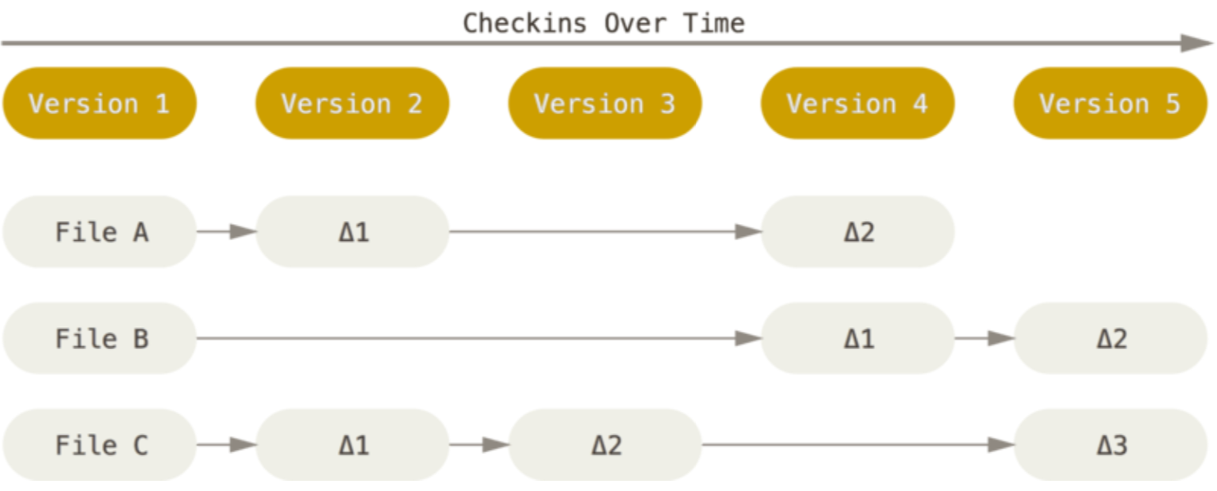
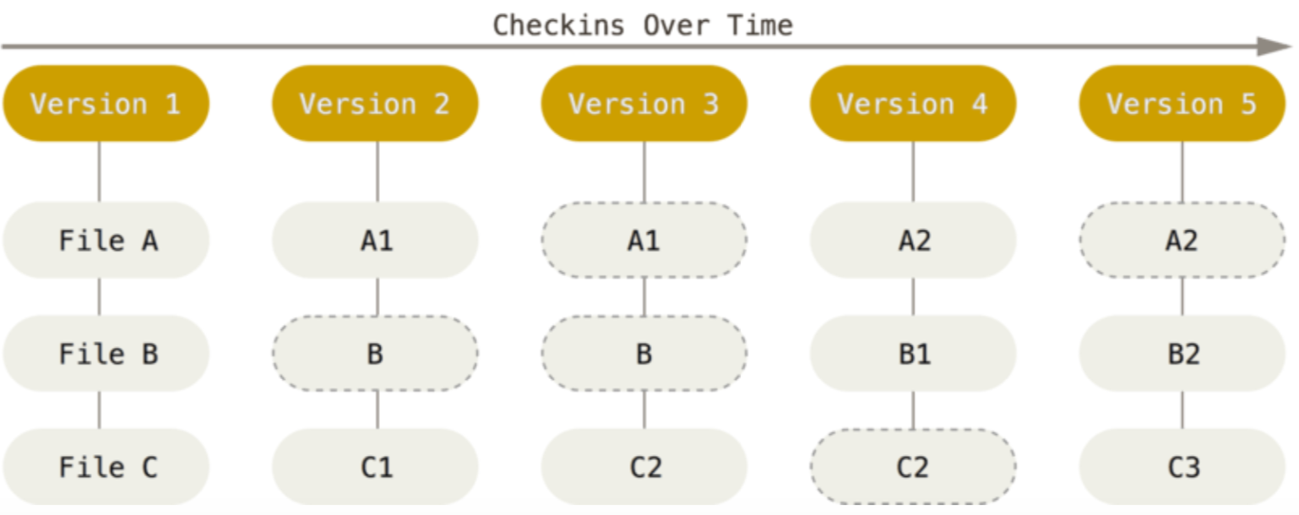
How other VCS’s do it (delta-based).
How Git does it
(snapshot-based).
Dashed ovals show that a pointer to the file has not changed.
Figures from Pro Git by Chacon and Straub

Slide 10
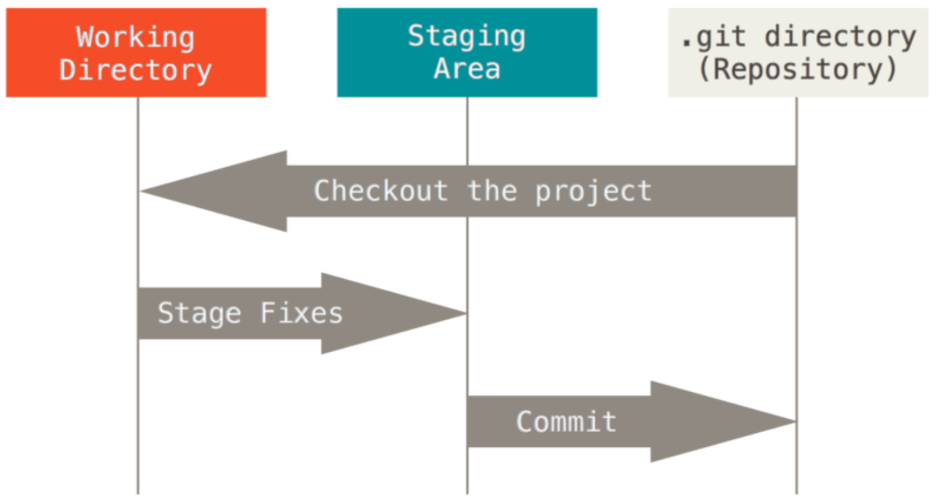
A single checkout of one version of the project.
git checkout main
git checkout 55c4277
The index that stores information for your next commit.
Local repo with objects and version metadata.
Figures from Pro Git by Chacon and Straub

Slide 11
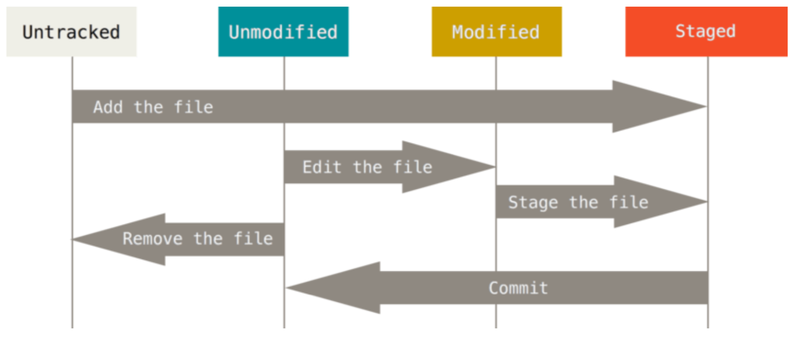
Lifecycle for a file in Git
Figures from Pro Git by Chacon and Straub

Slide 12
Things get interesting when we start involving multiple collaborators…

Slide 13
Scenario 1 between jbshep and BVCSDEMO
jbshep clones
bvcsdemo clones
jbshep adds, commit, push
bvcsdemo adds, commit, push (oh no!)
----
bvcsdemo git pull (file now has merge stuff… previous commit is thrown away)
bvcsdemo edit file
bvcsdemo add, commit, push
Do ‘git log’ on both Terminals
jbshep needs to do git pull (assuming he has no changes locally)

Slide 14
Notice the labeling on ‘git log’ output
Each commit has its own unique hash
We can refer to this hash (or just part of the beginning of it) when we perform different operations
Example: git checkout 55c4277

Slide 15
Scenario 2 between jbshep and BVCSDEMO
jbshep and bvcsdemo are sync’ed
jbshep makes a change to new file but does not add, commit, or push yet
bvcsdemo makes a change to existing file, adds, commits, and pushes
jbshep adds, commits, tries to push… error! Remote has changes jbshep doesn’t have.
jbshep tries git pull… previous push attempt already grabbed existing file changes
jbshep tries to push again. Previous commit was already thrown away. Need to recommit.
jbshep commits, pushes
bvcsdemo is behind and must git pull to catch up

Slide 16
AssignmenT
in-class
Instructions: https://github.com/jbshep/softeng21/blob/main/asgn/a2.md
Repo: https://github.com/jbshep/softeng21-a2/

Slide 17
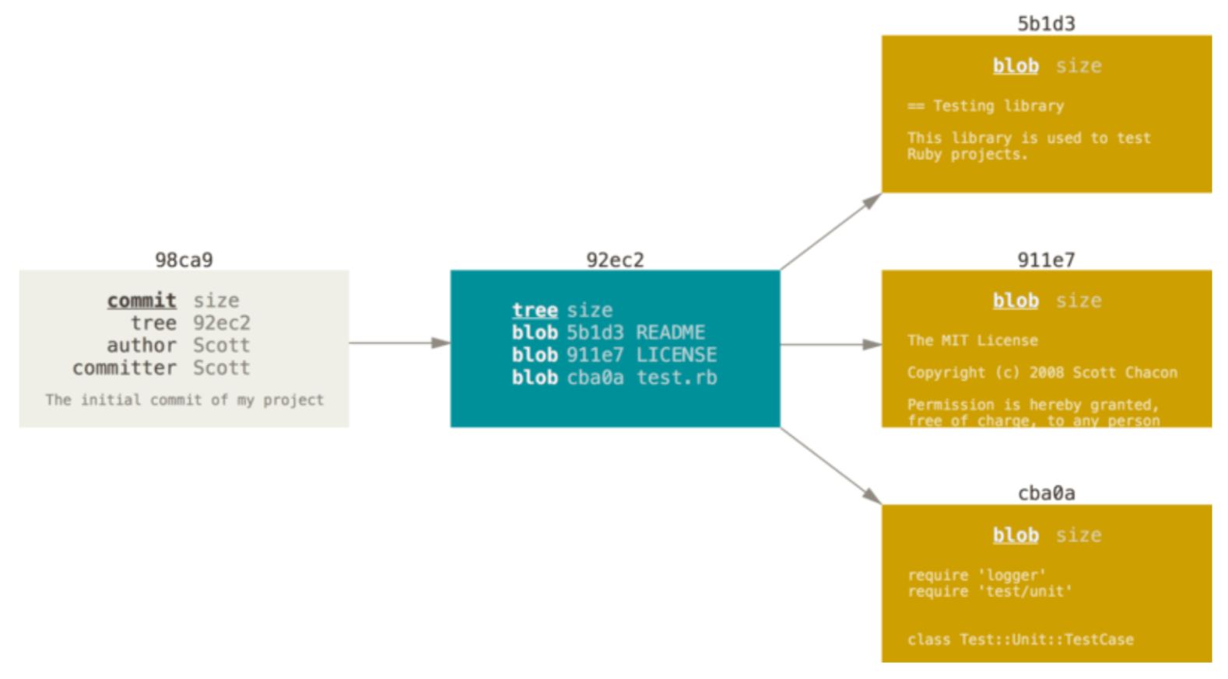
The anatomy of a commit
Figures from Pro Git by Chacon and Straub

Slide 18
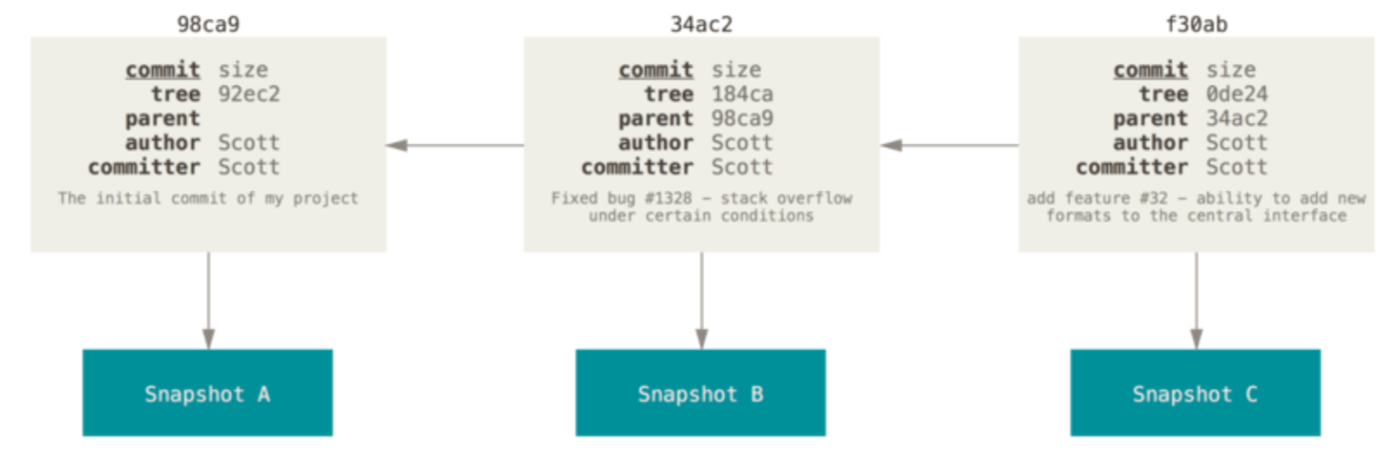
A series of commits
Figures from Pro Git by Chacon and Straub

Slide 19
Branches
A branch is a lightweight movable pointer to a commit.
Default branch is named main. (used to be known as master)
main points to your last commit in the main branch.
With each new commit, the main pointer moves forward automatically.
(Technically, you can rename the main branch something other than “main” but please don’t).
Our working directory has a HEAD pointer.
HEAD points to the last commit of the current branch.
HEAD points to main unless you change it.

Slide 20
Working with branches
git branch <new-branch> creates a new branch named <new-branch>
git checkout <branch-name> resets HEAD to <branch-name> and updates working directory
git checkout -b <new-branch> creates a new branch named <new-branch> and switches to it

Slide 21
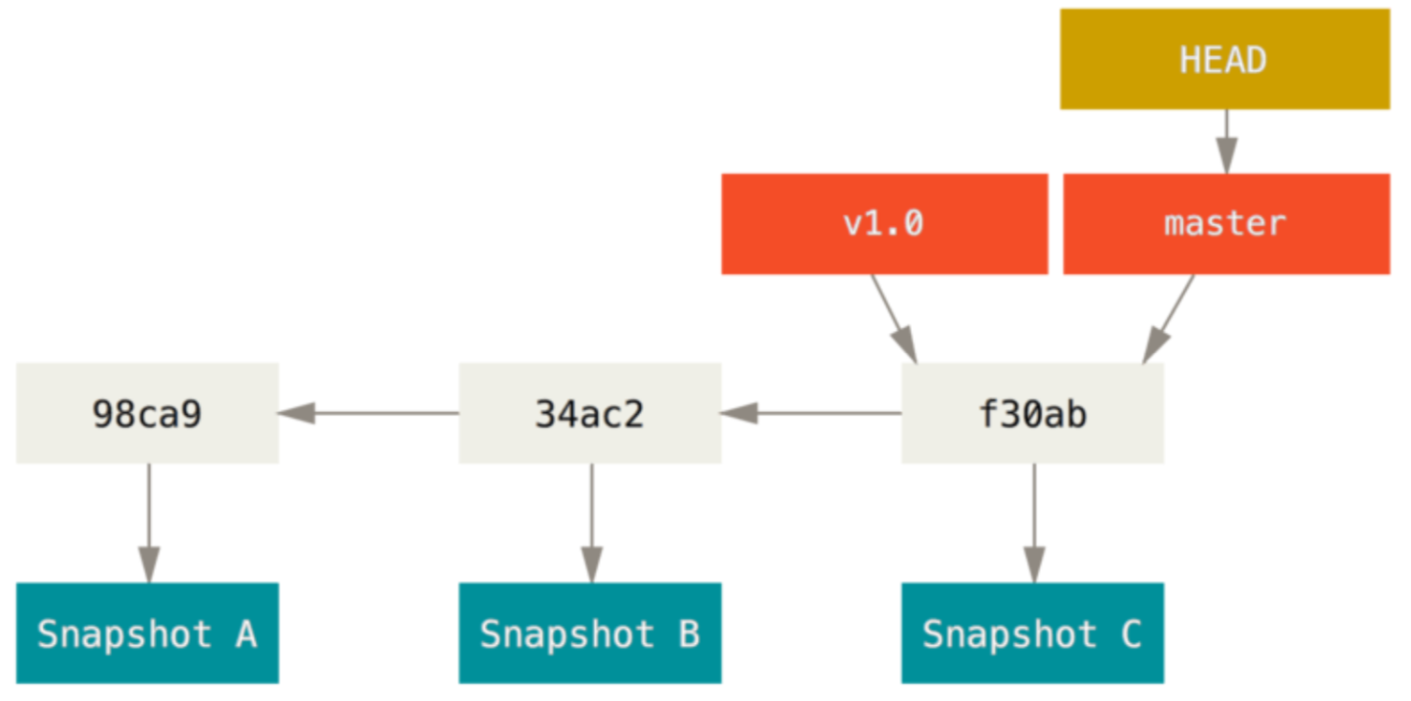
main
Figures from Pro Git by Chacon and Straub

Slide 22
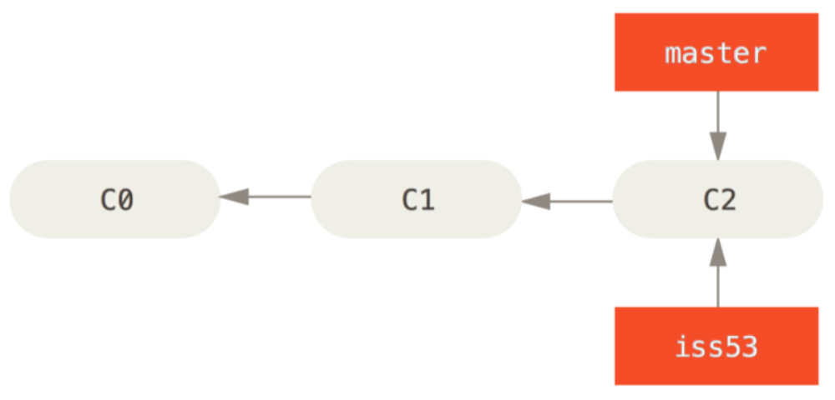
main
Figures from Pro Git by Chacon and Straub

Slide 23
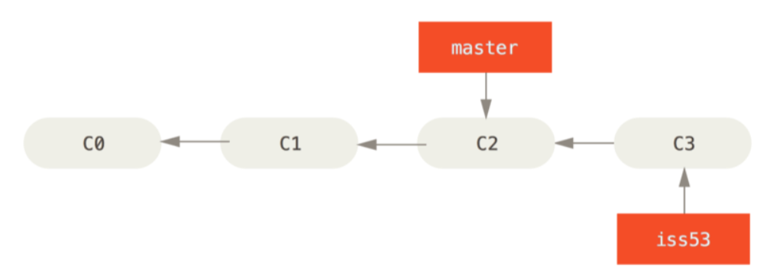
main
Figures from Pro Git by Chacon and Straub

Slide 24
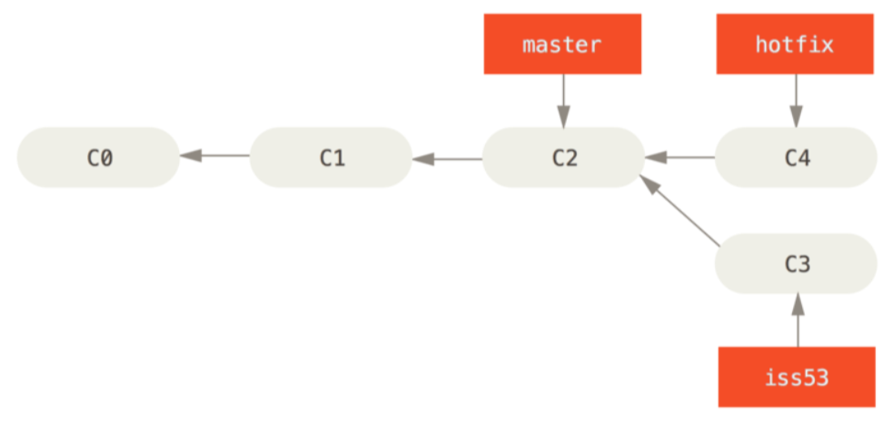
main
Figures from Pro Git by Chacon and Straub

Slide 25
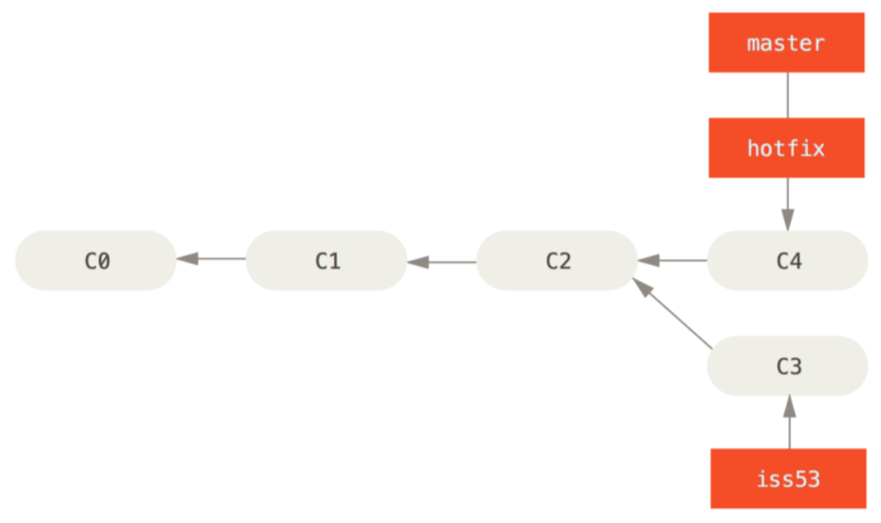
Merging back to main
main
git checkout main
git merge hotfix
main
Figures from Pro Git by Chacon and Straub

Slide 26
main
The merge of hotfix into main was a fast-forward.
If we 'git checkout iss53',
the iss53 branch does not have our changes found in main.
Our options are:
1.) 'git merge main' to pull our main branch changes into the iss53 branch, or…
2.) wait and merge iss53 changes into main later
Figures from Pro Git by Chacon and Straub

Slide 27
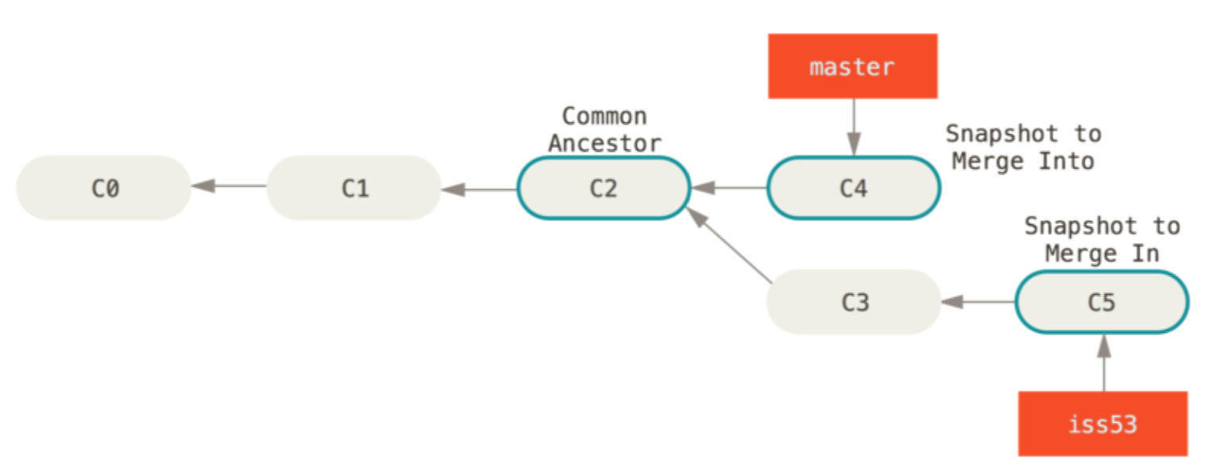
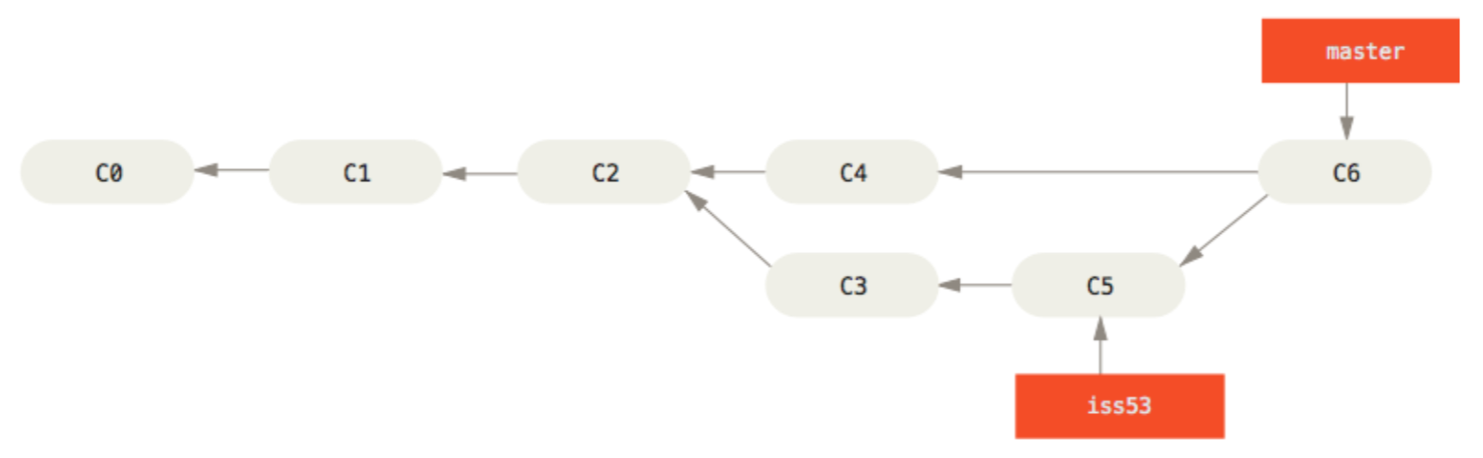
main
If we do option #2 from the previous slide (checkout main and then merge iss53), git does a three-way merge to create ‘C6’.
C6 is known as a merge commit.
main
Figures from Pro Git by Chacon and Straub

Slide 28
Remarks on Branching and Merging
If the merge isn’t automatic, Git walks you through the merge by putting differing code directly into the files that conflict. You choose the correct code.
Once you are done with a branch, you can delete it.
git branch -d <old-branch>
In other VCS’s, creating a branch is expensive. In Git, a branch is lightweight (i.e., just a pointer), easy to create, and easy to merge.
Creating several different topic branches is no big deal.

Slide 29
Getting the latest from Origin (GitHub)
git fetch origin
fetches latest code and metadata from origin (metadata → new branches and commits)
git pull
fetches latest code and metadata from origin and attempts to merge

Slide 30
You Try It
Grab a partner (or two).
One of you create a repo on GitHub and add your partner as a collaborator.
Don’t worry, you’ll delete your repo when you’re done.
Add some files.
Each of you create a branch and either add files, modify files, delete files, or all of the above.
Try merging your work back into the main branch.
Create several branches to get used to the workflow.

Slide 31
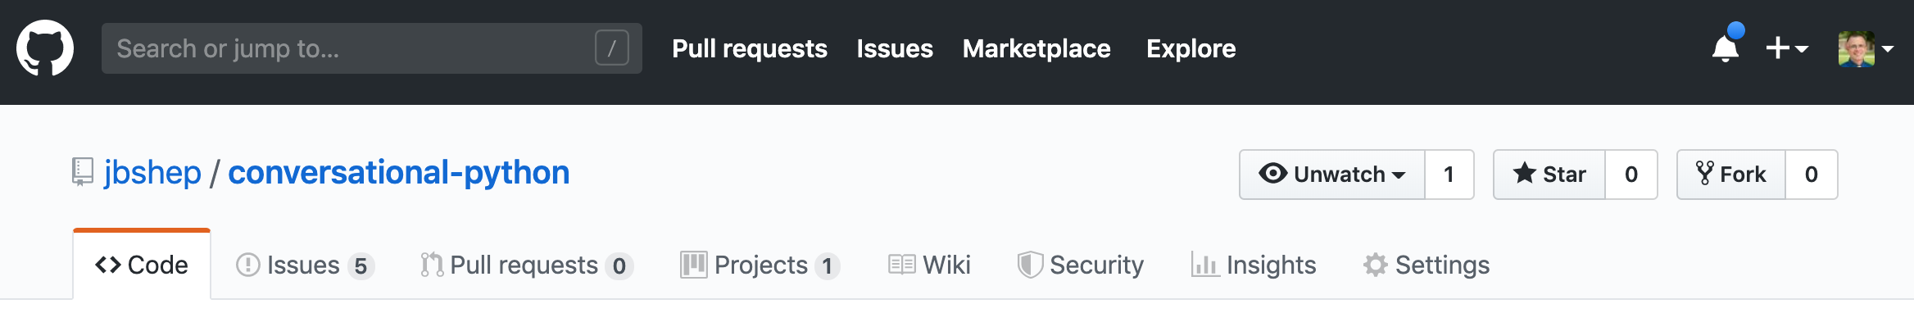
GitHub: Issues and Pull Requests
Issues:
Track coding work to be done (bug fixes, enhancements/features, etc.).
Pull Requests:
A more collaborative method for merging code to main from a topic branch.
If an Issue captures changes that are needed, Pull Requests contain commits in a branch intended to close that Issue.

Slide 32
A Tour of Using Issues and Pull Requests
Creating issues, pull requests, closing issues, etc.

Slide 33
Shared Repo vs. Fork-and-Pull
Shared repo model
Owner adds collaborators
Everyone clones repo and uses branches to perform work
Fork-and-pull
Owner allows others to contribute by “forking” a repo into their own GitHub profile
Others may add to their own main (or their own branches)
Others may request their code added to original repo by submitting a PR
Popular for open source projects (e.g., React, Flask, D3, Bootstrap)

Slide 34
Our Class Workflow
We will use the Shared Repo model.
Issues will be part of a milestone that is created by the Project Manager (PM).
PM rotates for each sprint/milestone.
Each Issue selected as part of a milestone will be assigned to two developers, who will pair-program.
We will (almost) always close Issues with Pull Requests
As opposed to commit messages, since a commit may not end up fixing the issue as the developer thought.
Creates “traceability” in terms of what code fixed what issue.
We can see commits were properly reviewed (both the code and any tests).
Exceptions: when Issue is for discussion and requires no “code” fix.
PM will review and will assign one additional reviewer to each PR (i.e., two devs, two other reviewers)

Slide 35
DEMO
PM creates a ‘staging’ branch for upcoming milestone
PM creates issue for milestone and assigns to dev
Dev does ‘git pull’ and creates a branch ‘feature’
Dev merges ‘staging’ into ‘feature’
Dev adds/commits/pushes and creates a PR (with issue # referenced)
PM assigns reviewer (possibly the PM)
Reviewer makes comments and requests changes
Dev adds/commits/pushes
Reviewer approves
PM merges PR, which closes PR and issue

